Slide 1
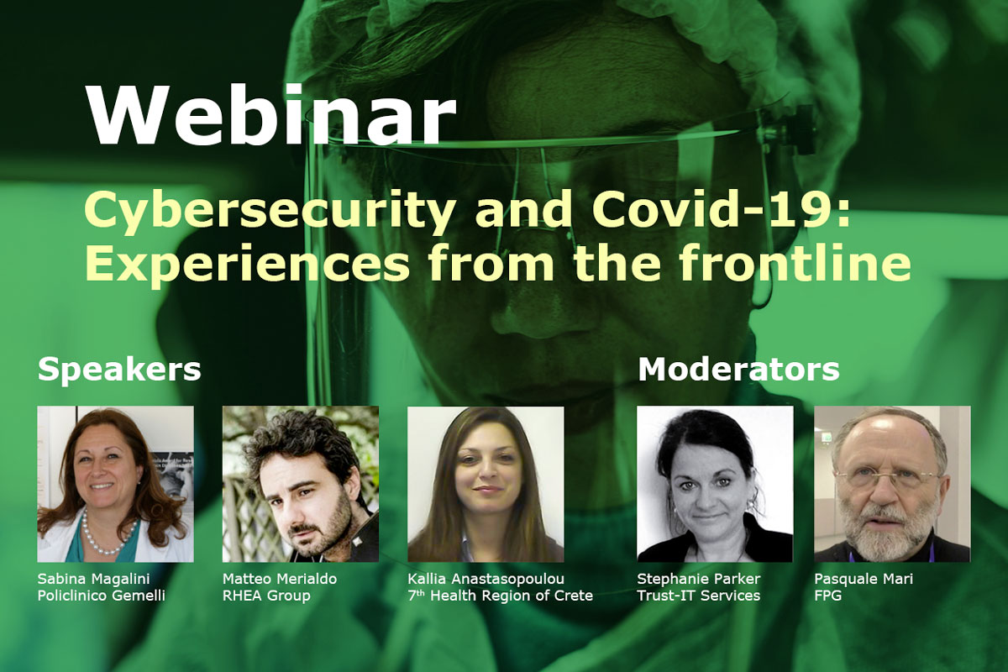
PANACEA: People-centric Cybersecurity in Healthcare

Slide 2
Agenda
Time Slot | Feature
11:00-11:05 | Welcome and Introduction, Stephanie Parker, Trust-IT 1st Interactive Poll
11:05-11:20 | Existing and new cyber threats to hospitals during COVID-19, Dr Sabina Magalini, Department of Surgery of Catholic University of the Sacred Heart and the Gemelli University Hospital
11:20-11:35 | IT Healthcare Readiness in the Face of Cyber Risks in EU Hospitals, Kallia Anastasopoulou, 7th Health Region of Crete
11:35 - 11:50 | PANACEA Toolkit in the Context of COVID-19, Matteo Merialdo, RHEA 2nd Interactive Poll
11:50-12:00 | Interactive Q&A Session Moderators: Pasquale Mari, Gemelli University Hospital and Stephanie Parker, Trust-IT

Slide 3
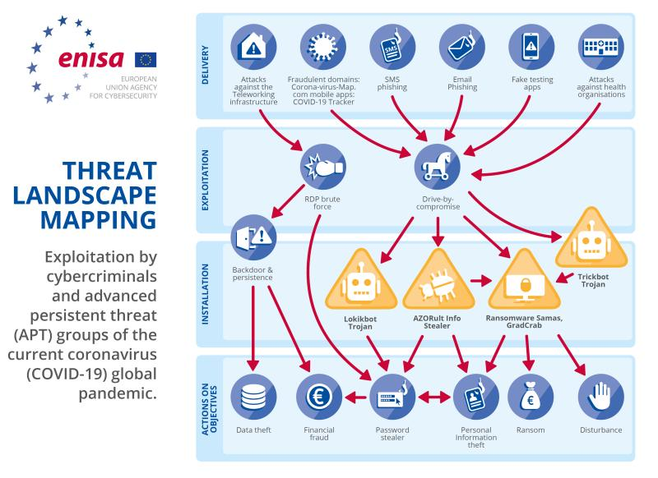
COVID-19: A growing cyber-threat landscape

Slide 4
Get involved: Join our Community!
www.panacearesearch.eu
Twitter: @H2020panacea
LinkedIn: /in/panacearesearch
YouTube: https://www.youtube.com/channel/UC5k4hx6IQiRd0nXNtWK_jMQ
Subscribe to our newsletter: https://www.panacearesearch.eu/newsletter
© Copyright 2018 - PANACEA has received funding from the European Union’s Horizon 2020 research and innovation programme under the Grant Agreement no 826293. The content of this document does not represent the opinion of the European Union, and the European Union is not responsible for any use that might be made of such content

