Slide 1
Webinar 23 June 2020
PANACEA Toolkit in the Context of COVID-19
Matteo Merialdo, PANACEA Technical Project Manager RHEA System S.A.
Funded by the European Union’s Horizon 2020 Research and Innovation Programme, under Grant Agreement no 826293

Slide 2
PANACEA is developing a suite of technological and organizational tools (Toolkit) which help users to assess and reduce the exposure to cyberattacks of their “system in scope”
System in scope include both technology and people
Systems in scope include
Healthcare organizations (single Hospital, Group of Hospitals)
Medical Device providers
Use of PANACEA tools will improve the general awareness and protection against cyber attacks, mitigating crisis situations
Each tool is cover specific needs, but their synergies is tailored to provide the best output

Slide 3
The PANACEA Toolkit includes
four technological tools for
I-dynamic risk assessment & mitigation,
II-secure information sharing,
III-security-by-design & certification,
IV-identification & authentication
three organisational tools for
V-training & education,
VI-resilience governance,
VII-secure behaviours nudging

Slide 4
PANACEA Solution Toolkit
Risk analysis and standards compliance applied to System Engineering life-cycle
Healthcare data secure information sharing
Multi tenant, cross border
Multi dimensional threat modelling
Attack modelling
Response management
Visual analytics
Secure behaviours decision models and influencers (e.g. Posters, Memes, Screensaver messages)
Biometric recognition/digital identity
2-factors authentication
Cybersecurity governance model to support HC organizations
Tailored awareness programs for HC organizations

Slide 5
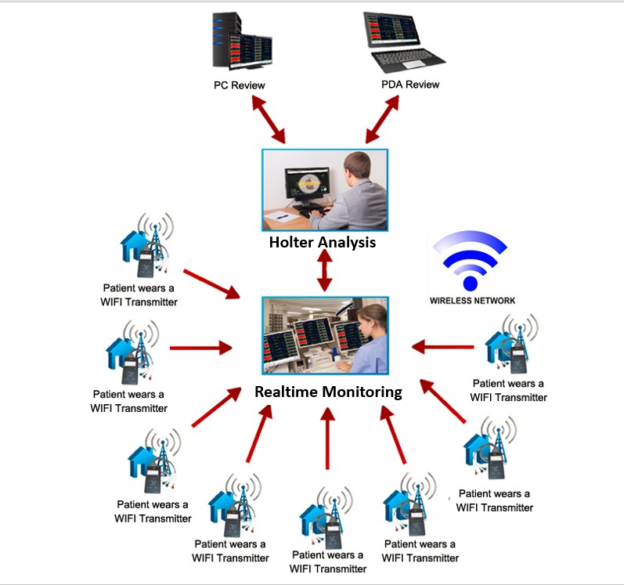
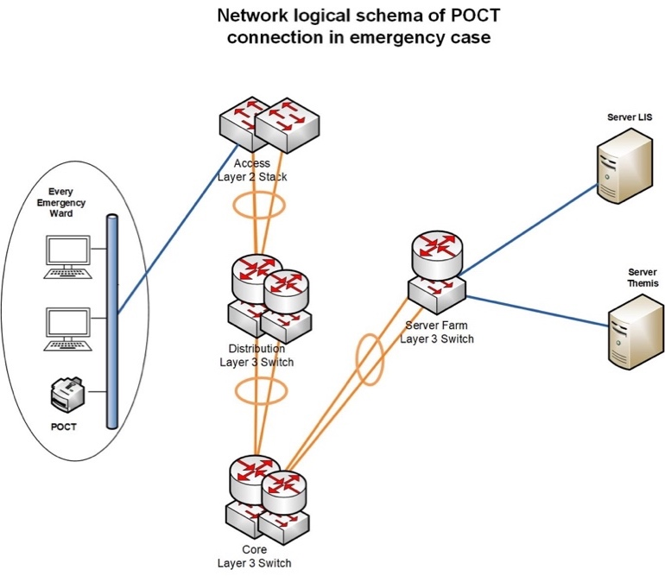
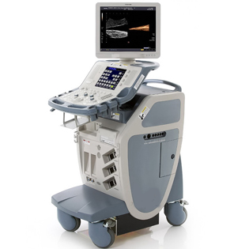
Dynamic Risk Management Platform (DRMP)
Visual Analytics Environment
Dynamic Risk Assessment and Mitigation for complex network infrastructure
Threat Analysis
Risk and Response Analysis
Data Collection, Aggregation and Analysis
Monitored Environment
External Repositories (vulnerabilities, threats, mitigation actions)

Slide 6
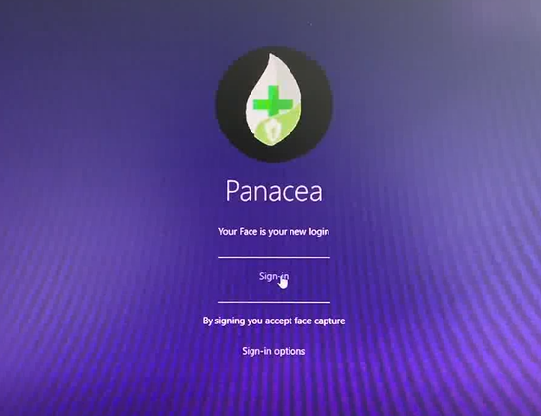
DRMP - Data Collection, Aggregation and Analysis
Multidimensional data acquisition and reachability computation of the monitored environment
Acquisition of IT infrastructure knowledge (scans, topology data-flows, assets characteristics)
Acquisition of vulnerability surface knowledge (scans)
Acquisition of users and users access information
Acquisition of business and governance models
Human Layer
Business Layer
Access Layer
Network Layer

Slide 7
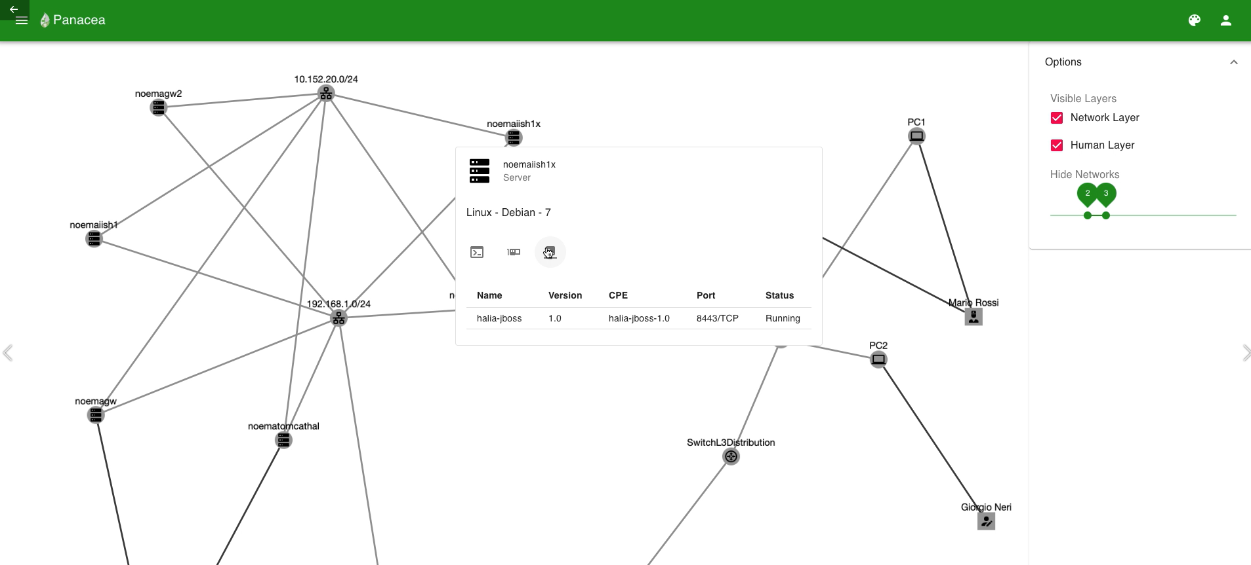
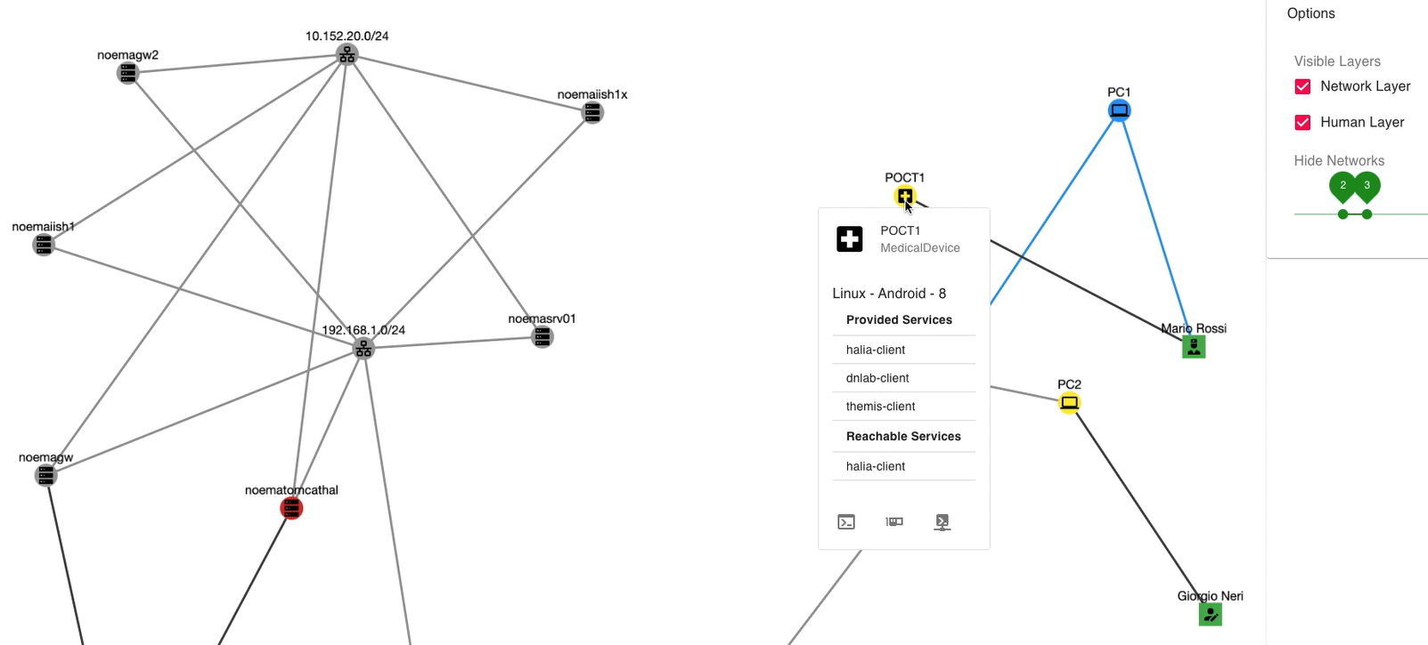
DRMP - Data Collection, Aggregation and Analysis
Flexible and open interface to COTS sensors and systems
Normalization of multiple data sources to a common data model
Advanced multilayered visualization

Slide 8
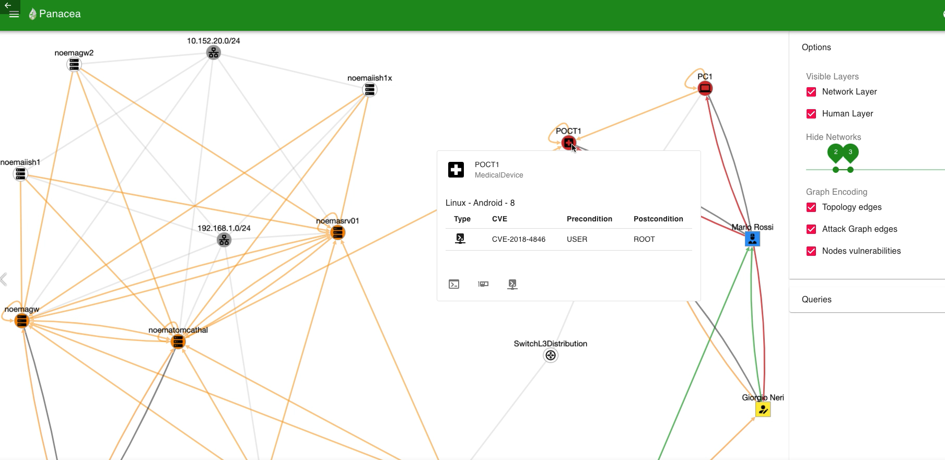
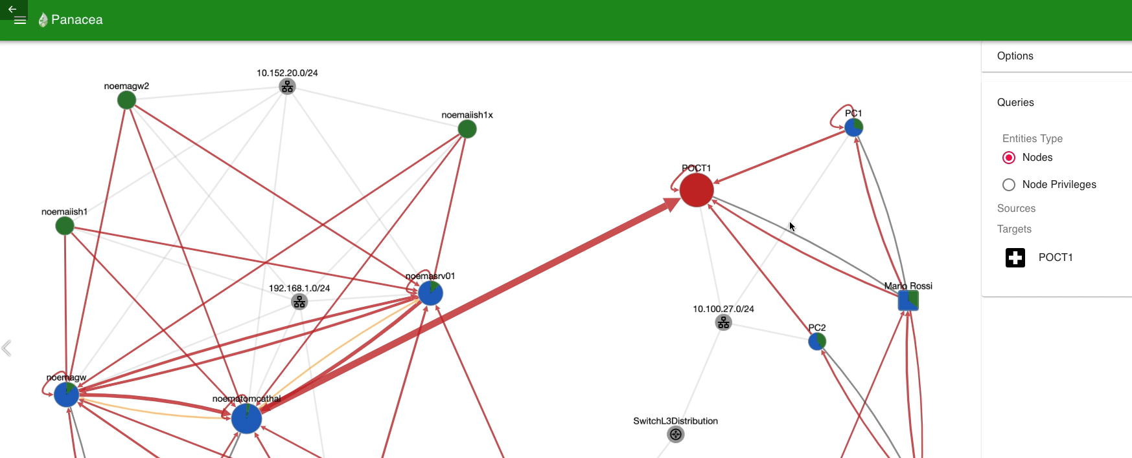
DRMP – Threat Analysis
Calculating and prioritizing possible attack paths within a graph
An attack graph represents possible ways via which an attacker can intrude into the target network by exploiting a set of vulnerabilities
The attack graph considers multidimensional paths (not only due to technical vulnerabilities but also related to humans and their access to the network)
Sharing credentials
Influence action
use
user@A
A
D
E
@A
A
CVE-2016-3169
B_{u}
CVE-2015-0078
B_{r}
CVE-2013-3678
_{C}

Slide 9
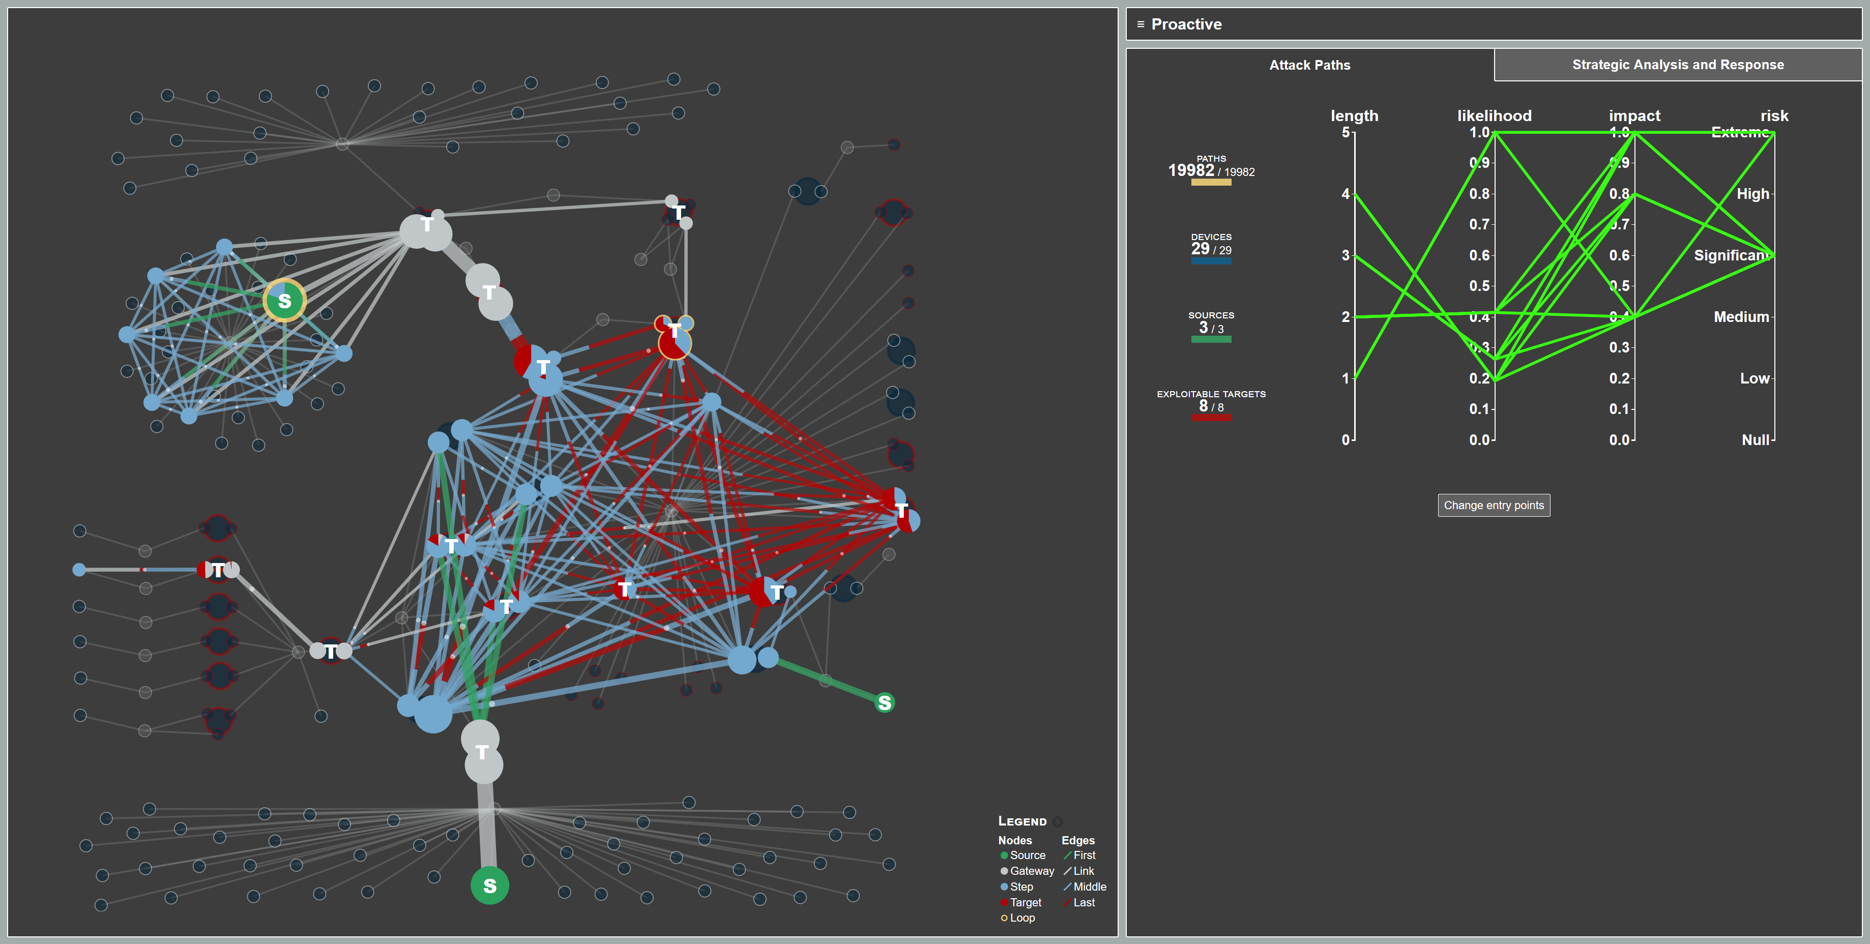
DRMP – Risk Evaluation
Based on the multidimensional attack graph and combined with
An evaluation of the business impact
Calculated from a precise mapping of key business processes vs infrastructural and human assets
Providing impact component for the risk computation

Slide 10
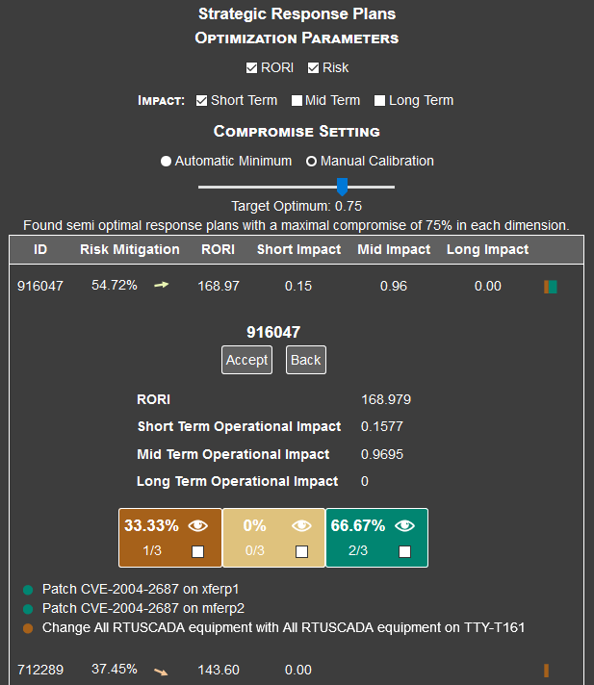
DRMP – Response Evaluation
Generating and prioritizing mitigation actions
A list of prioritized, specific and actionable risk-mitigation actions is then generated, based on cost / impact / risk reduction trade-offs
Secure behaviours nudging
Resilience
governance
Not only technical, but also governance, organizational and ‘human’ mitigation actions (nudging) to be considered by the response engine

Slide 11
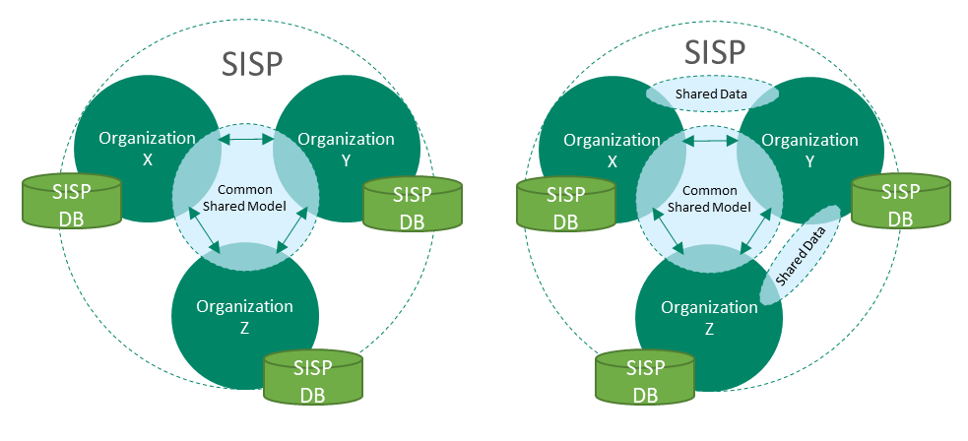
Secure Information Sharing Platform (SISP)
Secure information sharing for HC data

Slide 12
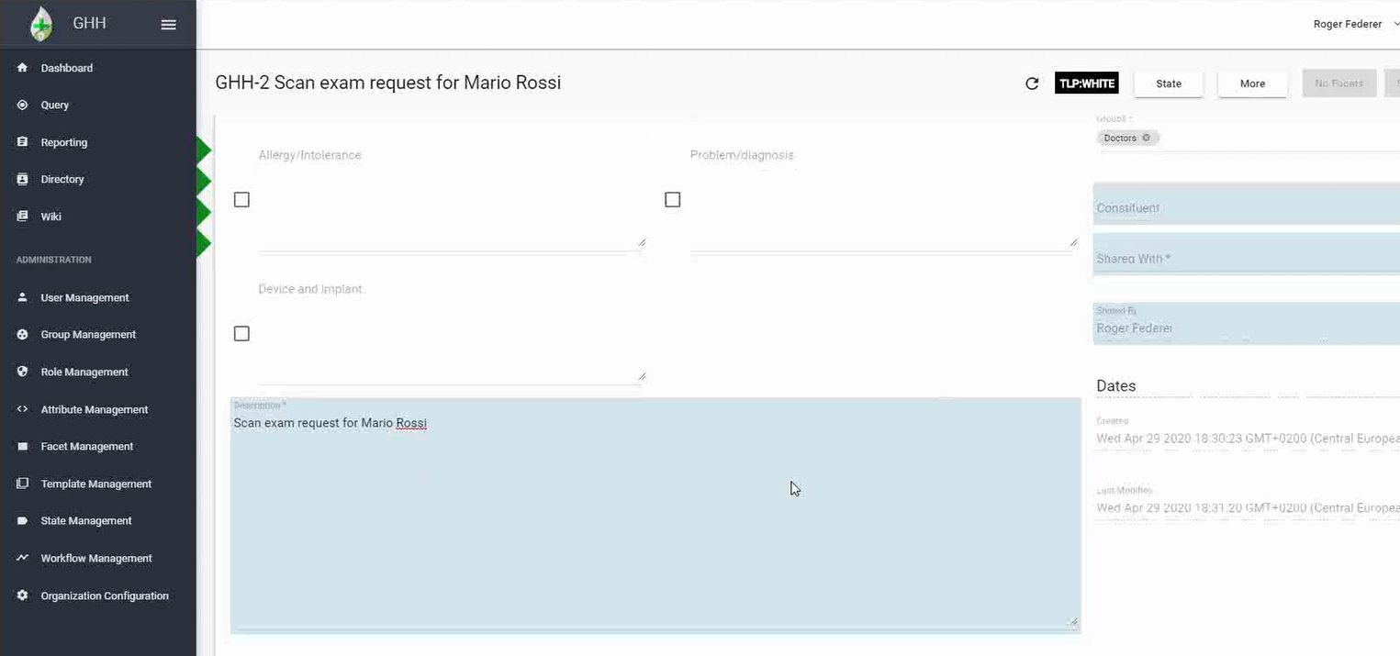
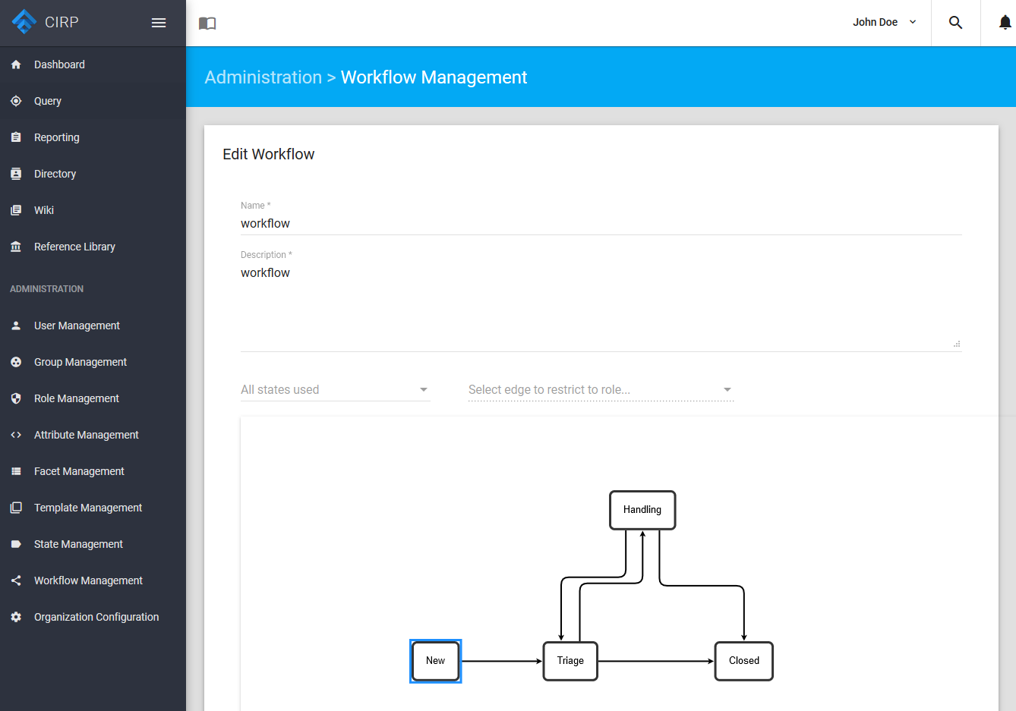
Secure Information Sharing Platform (SISP)
Fully distributed
Multitenant/Multiorganization
Cross border (multi regulation regulations compliance)
Customizable templates and data model
Customizable workflow
Shared knowledge management (wiki)
Internationalization and localization
GDPR compliant

Slide 13
Secure Information Sharing Platform (SISP)
Information sharing in HC is usually a manual process
Not efficient in pandemics
With SISP, real-time sharing of complex and huge HC data (including images) is possible
With security and GDPR as top priorities
Potentially, the SISP could evolve on a EU-wide HC Early Warning System!
Visual analytics
Relations and correlations between warnings
It would be possible to extract how a virus spread, find anomalies and/or make predictions

Slide 14
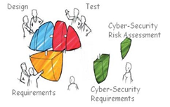
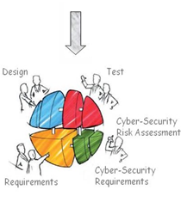
Security by Design Framework (SbDF)
PANACEA is developing a Security-by-Design Framework (SbDF) in order to overcome design limitations of medical devices and medical systems, which currently often do not specifically include security-engineering aspects
SbDF takes into account a typical assessment and system monitoring audit workflow with the support of specific solutions addressing conformity assessment and risk assessment

Slide 15
Security by Design Framework (SbDF)
The Security-by-design Framework is composed by two software solutions:
Secure Design Support Platform (SDSP)
It will support the security of a medical device/information system in development, by providing a software platform for risk assessment analysis over the system/medical device in development. Each risk assessment analysis may produce security controls that will lead to new requirements to be embedded in the system in order to improve its resulting security
Compliance Support Tool (CST)
It will support the quality assurance process during the whole lifecycle of a medical device/system, in order to put in place an assessment audit of the process supporting health devices/systems providers/quality responsible, ensuring compliance to current standards in the health sector

Slide 16
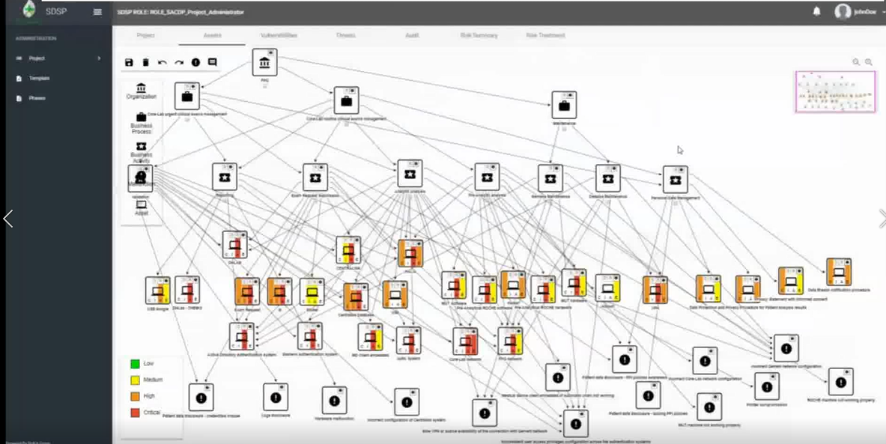
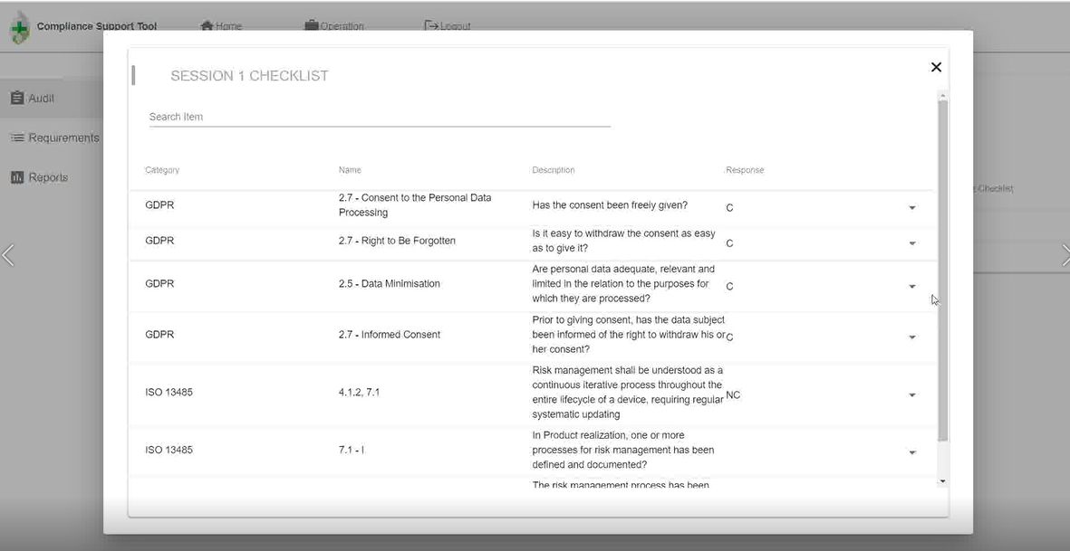
Security by Design Framework (SbDF)
The Security-by-design Framework is composed by two software solutions:
Secure Design Support Platform (SDSP)
Compliance Support Tool (CST)

Slide 17
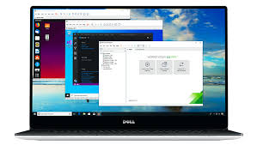
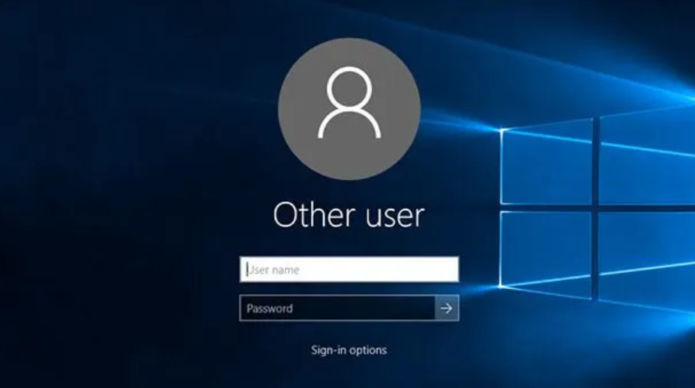
Today’s solutions to access HC systems
Identity Management Platform (IMP)
Usually based on :
Login/Password authentication (1 factor)
Windows Operating System (even for POCT)

Slide 18
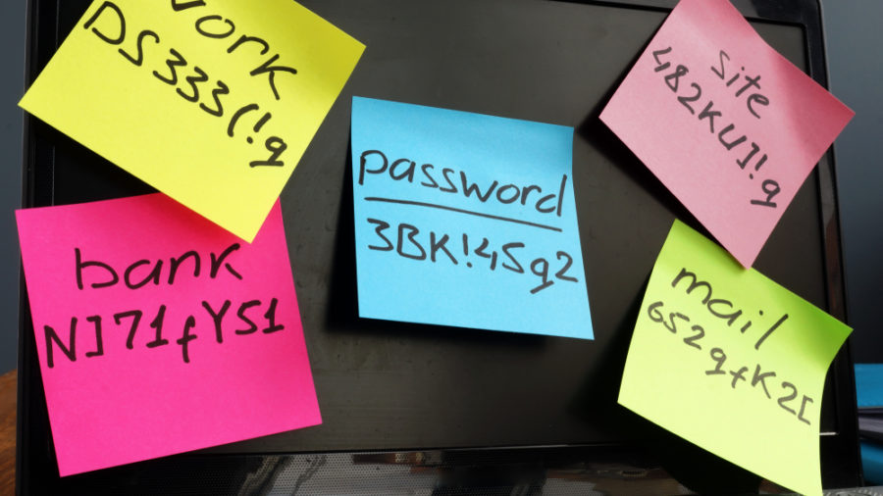
In practice
Identity Management Platform (IMP)
Credentials are written on post-it
People from the same team are often using the same credentials
Proper security behavior is greatly impacted during a crisis situation such Covid19

Slide 19
Requirements for a novel Platform
Identity Management Platform (IMP)
Easy to use and to be activated for new staff (relevant in crisis situations)
Secure (at least two-factors authentication)
Affordable (no expensive equipments)
Easy to integrate to the existing IT infrastructure
GDPR Compliant

Slide 20
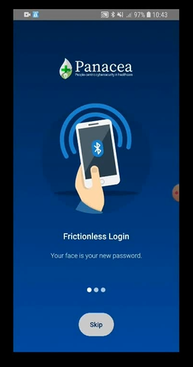
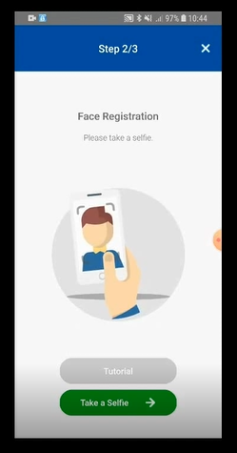
Identity Management Platform (IMP)
Based on a smartphone app
Biometric token is recorded and sent to the Identification repository in the HC organization
The token is also saved on the smartphone

Slide 21
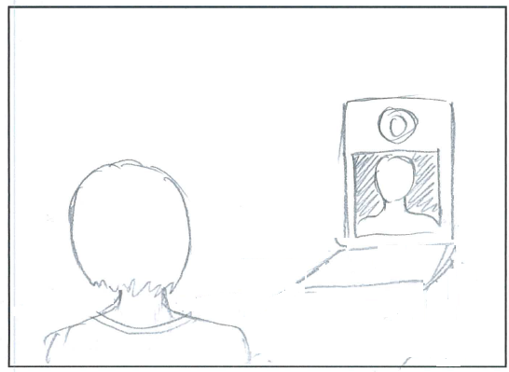
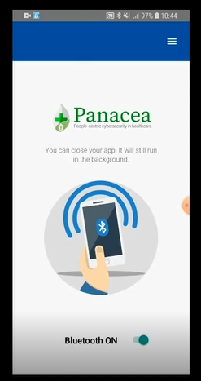
Identity Management Platform (IMP)
With Bluetooth activated, the proximity of the smartphone to the medical system is sufficient to trigger the identification of the User via webcam
We are currently improving identification also wearing masks

Slide 22
Thank you for your attention! Questions?
Main contact:
Sabina Magalini MD sabina.magalini@unicatt.it
Pasquale Mari, Policlinico Gemelli, pasqualemari3@gmail.com
Matteo Merialdo, RHEA System S.A., m.merialdo@rheagroup.com
www.panacearesearch.eu
Twitter: @H2020panacea
LinkedIn: /in/panacearesearch
YouTube: channel/UC5k4hx6IQiRd0nXNtWK_jMQ
© Copyright 2018 - PANACEA has received funding from the European Union’s Horizon 2020 research and innovation programme under the Grant Agreement no 826293. The content of this document does not represent the opinion of the European Union, and the European Union is not responsible for any use that might be made of such content

