Slide 1
Webinar 23rd June 2020
Cybersecurity and COVID-19: Experiences from the frontline
IT Healthcare Readiness in the Face of Cyber Risks in EU Hospitals
Kallia Anastasopoulou, PhD
7th Health Region of Crete
Funded by the European Union’s Horizon 2020 Research and Innovation Programme, under Grant Agreement no 826293

Slide 2
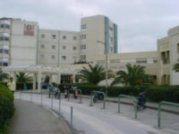
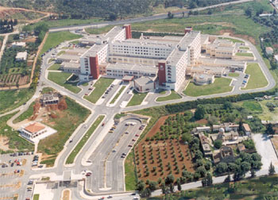
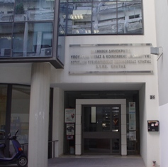
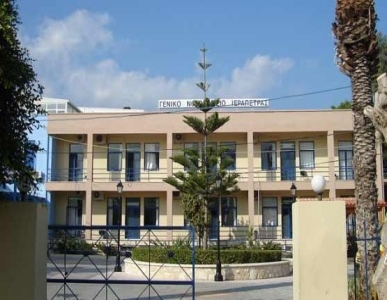
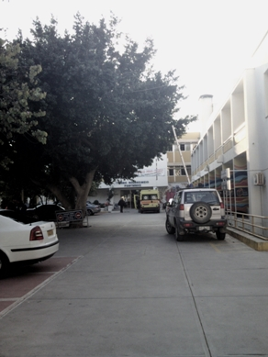
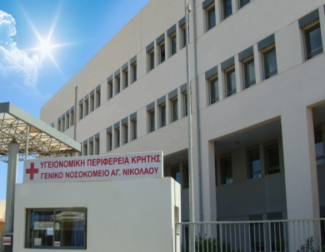
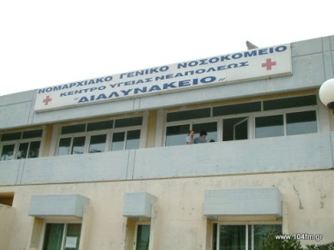
7th Health Region of Crete
The only Health Region in Greece operating an Integrated Health Information System at a regional level
Interconnection of hospitals and primary health care units under a common suite of applications
Innovative eHealth Services provided to patients
Highly qualified & experienced staff in administrative, scientific, technical and research terms

Slide 3
COVID‐19 as“surprise”? IT Healthcare is not ready to face Cyber Risks in EU Hospitals
EU mechanisms deal with pandemics: high expectations, limited tools
In Europe, the financial crisis led many Member States to impose drastic spending cuts on healthcare in almost every country. For instance, the OECD reported that following the economic crisis, health investments per capita in Italy decreased until 2013 and only started to increase very slowly after then (OECD, 2019)
Healthcare organizations are not always considered critical services for many countries (ENISA, 2017)
Low maturity on cybersecurity in healthcare (e.g. many hospital do not have a CISO) (ENISA, 2017)
Hospitals are easy targets for malicious attackers (e.g. ransomware attacks in hospital across the EU) (ENISA, 2017)
Lack of security awareness in the involvement stakeholders (e.g. physicians, administrative staff, patients) (ENISA, 2017)
Life span of medical devices in use (e.g. MRI machines can be outdated and patch management process is a 3rd party task to perform) (ENISA, 2017)
Most EU countries are wildly unprepared, and the existing coordination mechanisms appear too weak to effectively prevent collective action problems, as well as fragmented and sparse reactions, to proliferate (OECD, 2019)

Slide 4
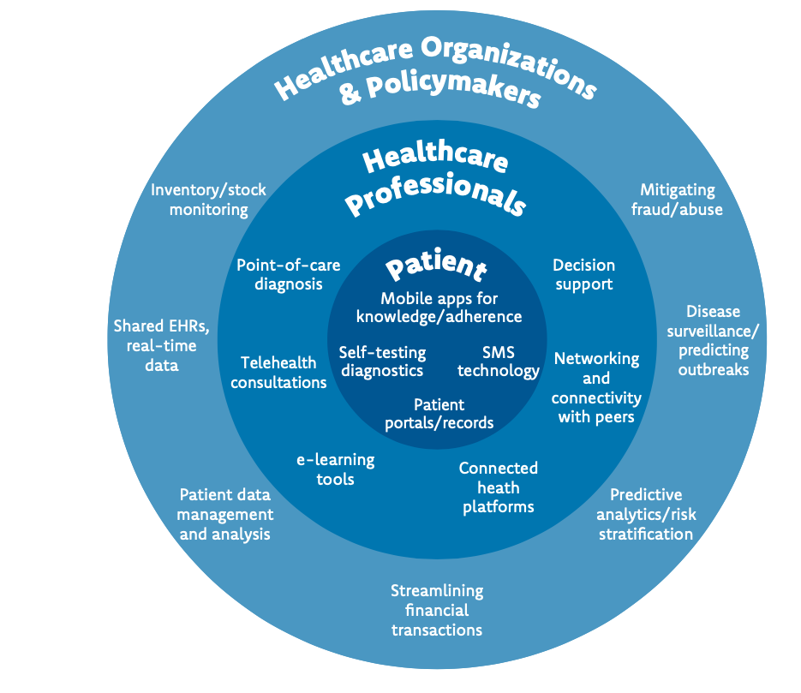
Digital health describes the general use of ICT for health and is inclusive of both mHealth and eHealth (WHO,2016)
Since the beginning of the COVID-19 crisis, a variety of mobile applications have been developed to
(i) facilitate the organisation of medical follow-up of persons with symptoms
(ii) warn people who have been in proximity to an infected person in order to interrupt infection chains
(iii) monitor and enforcement of quarantine of infected persons (EU recommendation 2020/518)

Slide 5
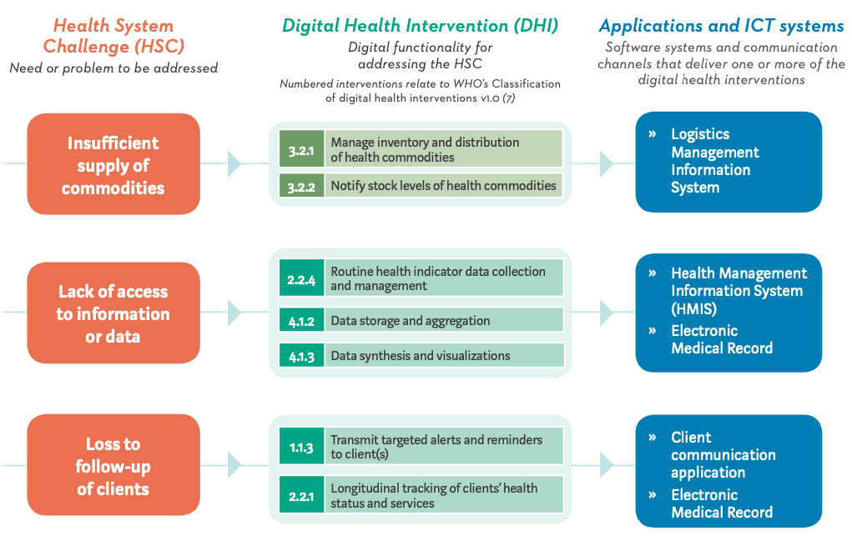
How digital health intereventions may address health system challenges, implemented through ICT sytems (WHO,2018)

Slide 6
COVID‐19 as an emerging risk
How Hospitals Are Dealing with the Cybersecurity Challenge of COVID-19?
Many hospitals, for instance, add new medical devices to their networks to help increase their volume of patient care.
Many also open field hospitals and testing sites on top of their existing environments.
New network infrastructure is being installed at remote sites, such as wireless access points, as well as additional telemedicine capabilities such as more iPads and loaner infusion pumps.
Healthcare organizations are being targeted by ransomware attacks. While ransomware attacks aren’t a new trend for this industry, the combination of increased critical care needs with the disruption of operations from cyberattacks could put more lives at risk than ever before.
COVID19 bring new risks!
“new and/or increasing” risks can be related to different areas of activities, such as new processes, new technologies, new types of workplace, or social or organizational change.
risks will interrelate with the processes like globalization, digitalization, innovation, cross boundary operations and many others, inextricably, directly or indirectly influencing each other, being interconnected, systemic and/or interdependent.

Slide 7
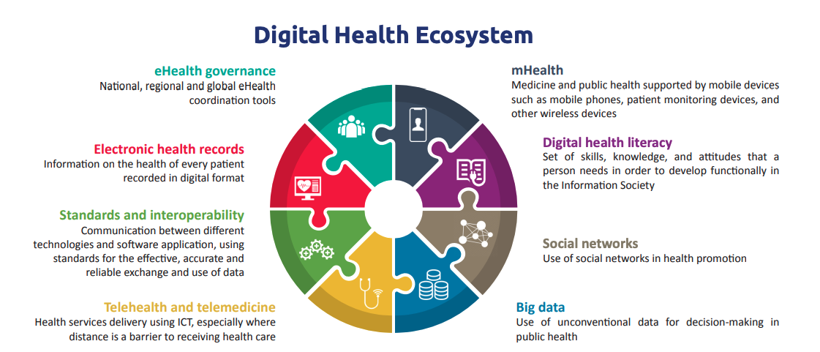
IT Healthcare Cyber Risks in EU Hospitals
Attacks against the Teleworking infrastructure
Email phising
Fake testing apps
Attacks against health organisations
Actions
Data theft
Financial fraud
Password stealer
Personal Information theft
Ransom
Disturbance
(ENISA, 2020)
(WHO, 2017)

Slide 8
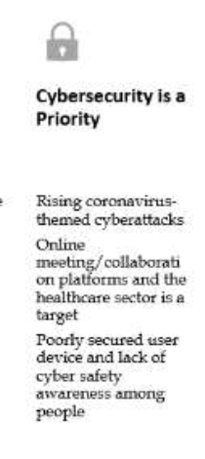
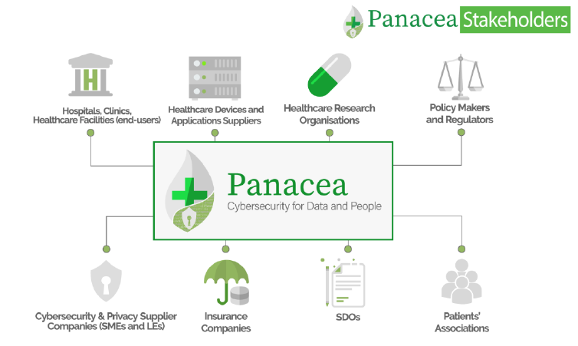
LESSONS LEARNED FROM COVID-19 (Priyanka et al.,2020)
Transformation of the Healthcare Sector
COVID-19 has made us understand the value of good health and the significance of the healthcare sector
The need for centralized patient records is felt as medical staff treating COVID-19 patients find it difficult to track some of the patients, especially when they are transferred from one medical institution to another for better observation and care
The healthcare sector must start digitalizing all their processes and records so that treatment is efficient and medical staff does not have to be burdened by tracking medical paper records
Upgrading digital infrastructure in medical institutions would become essential once the healthcare sector goes digital
Proper security technologies, controls and administration should be put in place to ensure a secure and robust environment for their operations and processes
The COVID-19 pandemic has contributed to the emergence and growth of e- doctor and e-pharmacy services that enable people to consult a doctor or pharmacist, get a prescription, get medical products or simply get health advice - all from the comfort of their homes via smart gadgets
Cybersecurity is a Priority
Coronavirus-themed cyberattacks are a huge hit, with phishing scams leading the troop
In worse case scenarios, heartless, ethicless hackers target the healthcare sector to exploit medical resources and deny access to critical care systems that can cause deaths
The centre of attention for hackers during COVID-19 is online meeting and collaboration platforms. Since everyone is working from home, meetings are conducted online, and utilizing some of the popular online services/tools narrows down the scope for hackers.

Slide 9
Webinar 23rd June 2020
Cybersecurity and COVID-19: Experiences from the frontline
IT Healthcare Readiness in the Face of Cyber Risks in EU Hospitals
Thank you for the attention
Kallia Anastasopoulou, PhD 7th Health Region of Crete
Funded by the European Union’s Horizon 2020 Research and Innovation Programme, under Grant Agreement no 826293

