Slide 1

“Front-line” experience with healthcare cybersecurity in the Covid-19 context
Sabina Magalini MD
Surgeon in the Department of Surgery of Catholic University of the Sacred Heart and Policlinico Gemelli
H2020 Panacea Project coordinator
Funded by the European Union’s Horizon 2020
Research and Innovation Programme, under Grant Agreement no 826293

Slide 2
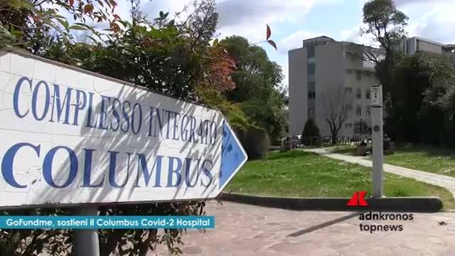
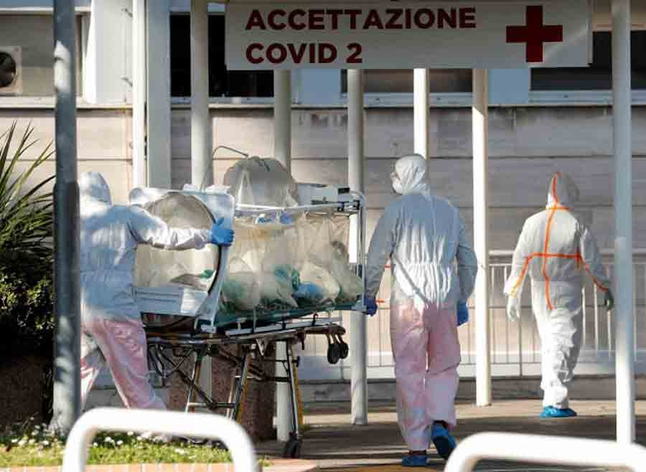
Fondazione Policlinico Gemelli
Notes:
This is the Fondazione Policlinico Gemelli of Rome Italy. The Hospital structure which is coordinating PANACEA a TDS02 H2020 prece on people-centric cybersecurity in Healthcare. After one year and a half of a tight scheduled project in march Italy lockdown for the COVID 19 pandemic and a wide spread hospital surge took place all over Italy. In Rome 5 COVID-19 Hospital points were identified and the Policlinico Gemelli was the number two right after the Spallanzani Hospital.

Slide 3
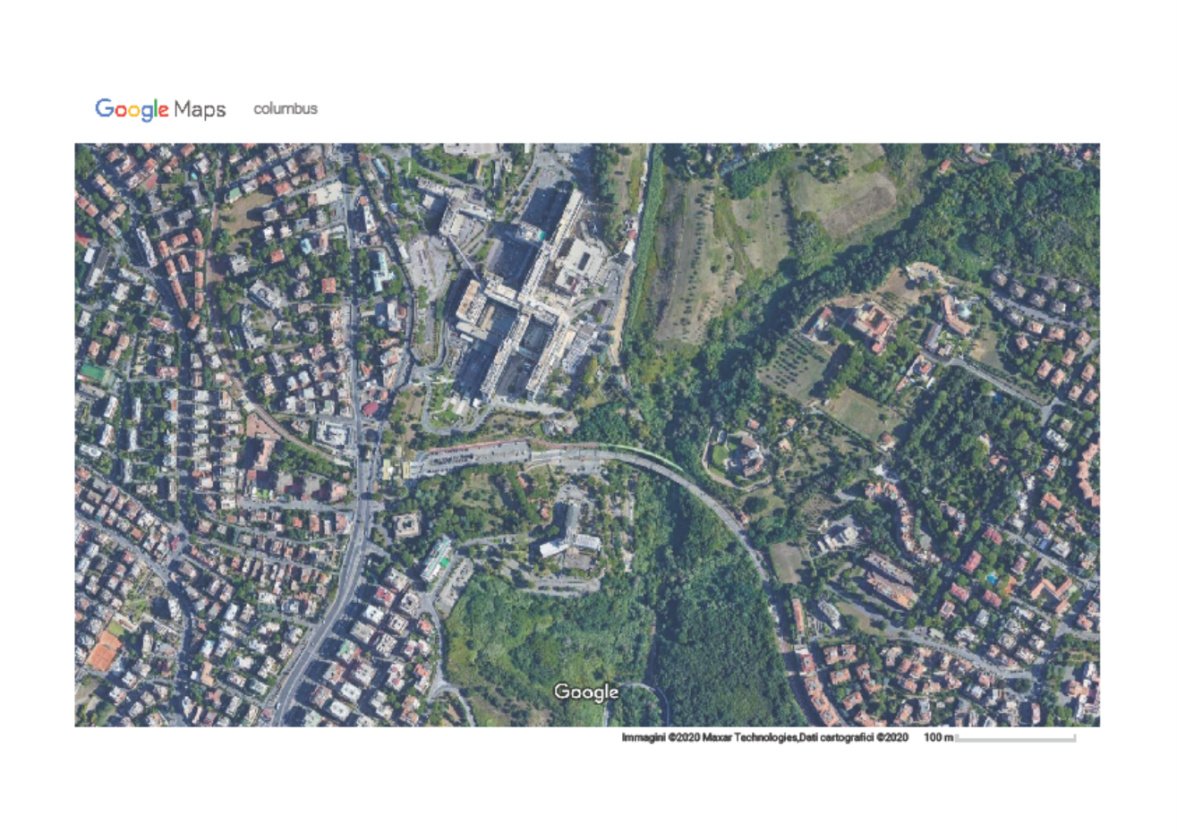
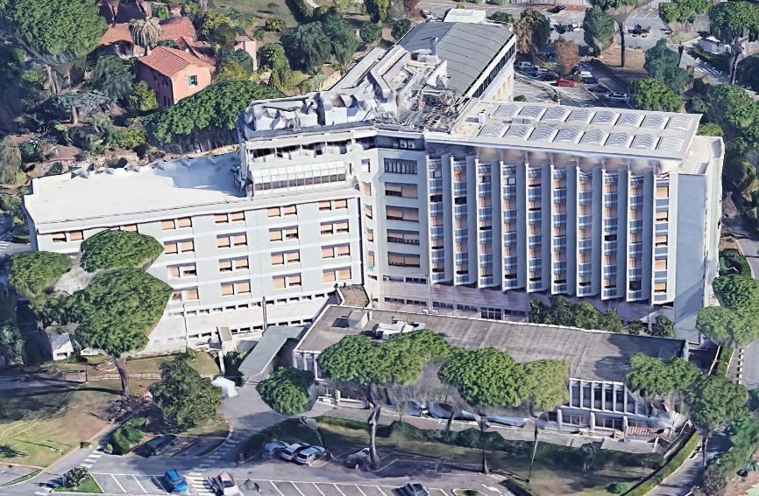
Fondazione Policlinico Gemelli
Policlinico
Gemelli
COVID 2 Hospital Rome
Columbus
Notes:
What you see on the map is the Major Hospital and the close by clinico Columbus which was emptied, refurbished as a COVID Hospital and activated in one week time. I did non evidentiate the close by Couryard Marriott Hotel that was used as a discharge Center for COVID patients which could not go home and had to stay in quarantine. Over 100 intensive therapy beds were activared and over 250 normal ward beds.
As you can see the surge was impressive.

Slide 4

How COVID-19 has influenced Hospital Cybersecurity
Healthcare sector has been too busy to take care of cyberthreats specifically targeted to Hospitals and other Healthcare facilities.
Operators are tired, overworked, wearing personal protective equipment and many of their cybersecurity behaviours are “relaxed”.
The surge and “panic” situation experienced has made the usual threats more insidious.
How can we mitigate the risks, now or in view of the next similar crisis?
Notes:
Well known cybersecurity threats have already been addressed by our project, but when COVID 19 came along some of the pre-existing situations worsened.

Slide 5
Types of cyber-attacks related to Covid-19 crisis situation
Phishing: coronavirus-themed phishing emails, where if one clicks a link, the fraudster could steal personal data, email logins or banking details.
Malware: spyware and trojans have been found embedded in interactive coronavirus maps and websites dealing with corona virus; domains in the internet contain the terms: "coronavirus", "corona-virus", "covid19" and "covid-19”; these maps are visited frequently by healthcare operators. Defacing of Coronavirus sites has been the rule.
Fraud: Hospitals and Healthcare agencies are ordering like crazy so as not to remain without stuff. Cases of paid orders of equipment, from face masks to hand sanitisers, that never arrived, are reported.
Scammers: have been seen to mimic groups such as the Centre for Disease Control and Prevention (CDC) or the World Health Organization (WHO), with links redirecting to a page where data are stolen.

Slide 6
New vulnerabilities due to Covid-19 crisis situation
Telemedicine: the policy to keep non severe COVID patients at home + the need for telemonitoring other patients due to the closure of many clinic services, expand the use of telemedicine, that has low level of security.
Infection monitoring data flows: there has been a major request of data flux to monitor infections, to do epidemiological reporting, etc. These data fluxes take place between Hospitals, Healthcare services and Regional or National Authorities; information sharing has low level of security.
New Apps fast design: Healthcare sector needs to rapidly design and deploy Apps and back-end systems to better manage actual and potential COVID-19 patients. Fast design risks to deliver non secure solutions.

Slide 7
Vulnerabilities due to Covid-19 crisis situation
Smart work: Risk may come from technology illiteracy of the staff at home; increased risk of infection due to connections from home devices potentially defenceless (antivirus, patching, antimalware); carelessness in exchanging credentials with colleagues to VPN or shared folders.
Non-healthcare sites used for healthcare operations: Temporary Hospitals, Churches, nearby Hotels, other empty but usable spaces have been upgraded to “hospital level” with consequent information fluxes. WIFI systems of these structures (e.g. Hotels) in general are not secure. Hackers can monitor traffic over air to steal access credentials.
Use of new staff: newly hired healthcare personnel are inexperienced of company cybersecurity policies, and of the work environment (colleagues, superiors, accepted behaviours); moreover many of them are “Digital-natives, Generation Z” and take cybersecurity for granted, even if it’s not true; sudden arrival of massive new staff can weaken the provisioning, de-provisioning and profiling processes, leading to security issues.
Staff-shifting from low output clinics to new positions utilizing the same credentials

Slide 8
What Governments/EU can do
In US there are numerous initiatives in which the Government is stepping in to help Hospitals secure their systems.
Before there was scarce intervention of Federal or National Cybersecurity Agencies for Healthcare domain, but now:
  Many campaigns are starting with Government giving more information to have healthcare operators to understand the risks
  there is a push toward a better healthcare cyber echo-system.
  Government is doing more Cyber-hygiene Scanning.
  EU has released guidelines on various sectors: Tracing Apps to support gradual lifting of confinement measures, Guidelines for Clinical Trials on COVID patients
  Progress is ongoing in health-related aspects of the NIS Directive. A newsletter item is under preparation.
  In Greece for remote working the Hellenic Data Protection Authority has released a brief guide targeted at Data Privacy Protection,
  AIFA (Italian Agency of Pharma) issued guidelines for data protection in the context of clinical trials from remote

Slide 9
Thinking ahead for a Hospital Structure
Which of the emergency measures that were put into place need a closer look (from a security perspective). And which are here to stay
How have attackers modified their approach to the current dynamics in healthcare? And what to look out for.
What we predict the “new normal” is going to be.

Slide 10
What can PANACEA Toolkit do (1/2)
PANACEA project will deliver, by end 2021, seven Tools, to improve cybersecurity preparedness of three types of “objects”
Technical Tools
Medical Device Lifecycle
HC
Organizations
HC
Information Systems Lifecycle
Non-Technical Tools

Slide 11
What can PANACEA Toolkit do (2/2)
HC organizations adopting PANACEA toolkit could reduce their vulnerability to cyberattack in a Covid-19 crisis situation, where “fast action” and “secure staff behaviour” are key.
Panacea Tool | How the Tool can support
Dynamic Risk Assessment platform | The tool allows to rapidly simulate new types of attack and automatically provides remediation actions, ranked by priority
Inter-organizational Information sharing platform | The tool allows the fast activation and use of a secure clinical data and image sharing mechanism based on “ready-to-use” federation agreements and protocols
Two-factor biometric identification solution | The solution uses password + face identification (through employee’s smartphone) to access both workstations and medical devices; it easily activated also for new staff (can use her smartphone)
Security by Design framework | A “secure software design check-list” ensures that both the design process and its “product” (e.g. an new App, a new certified diagnostic device, a new networked system) are secure
Method for “nudging interventions” development | The method is used to rapidly identify, design and deploy “nudges” to get secure behaviours from “old” and “new” staff (e.g. Posters, Memes, Screensaver messages) specific to the crisis at hand
Training package for cybersecurity awareness | The training package includes e-self-learning and remote training delivery solutions, quite suitable in a crisis where face-to-face interaction is not possible and “mass training” is needed in short time
Cybersecurity organizational governance model | Panacea has designed an organizational model based on a “core” team IS experts (CISO, …) + Information Security Reference Persons operating in each Department (and members of a Cybersecurity & Data Privacy team, chaired by the CISO): this ensures fast development and diffusion of policies specific to the crisis at hand

Slide 12
















Thank you for your attention! Questions?
Main contact:
Sabina Magalini MD
sabina.magalini@unicatt.it
www.panacearesearch.eu
Twitter: @H2020panacea
LinkedIn: /in/panacearesearch
YouTube: channel/UC5k4hx6IQiRd0nXNtWK_jMQ
© Copyright 2018 - PANACEA has received funding from the European Union’s Horizon 2020 research and innovation programme under the Grant Agreement no 826293. The content of this document does not represent the opinion of the European Union, and the European Union is not responsible for any use that might be made of such content

